Slide 1

Television Series or Television Shows?

Slide 2


01
Guessing game

Slide 3


What is this type of TV Series/ Show?
Cooking Show

Slide 4

What is this type of TV Series/ Show?
Crime Series

Slide 5

What is this type of TV Series/ Show?
Reality Show

Slide 6

What is this type of TV Series/ Show?
Educational Series

Slide 7

What is this type of TV Series/ Show?
Game Show

Slide 8

What is this type of TV Series/ Show?
Sitcom Series

Slide 9

What is this type of TV Series/ Show?
The Late night Show

Slide 10
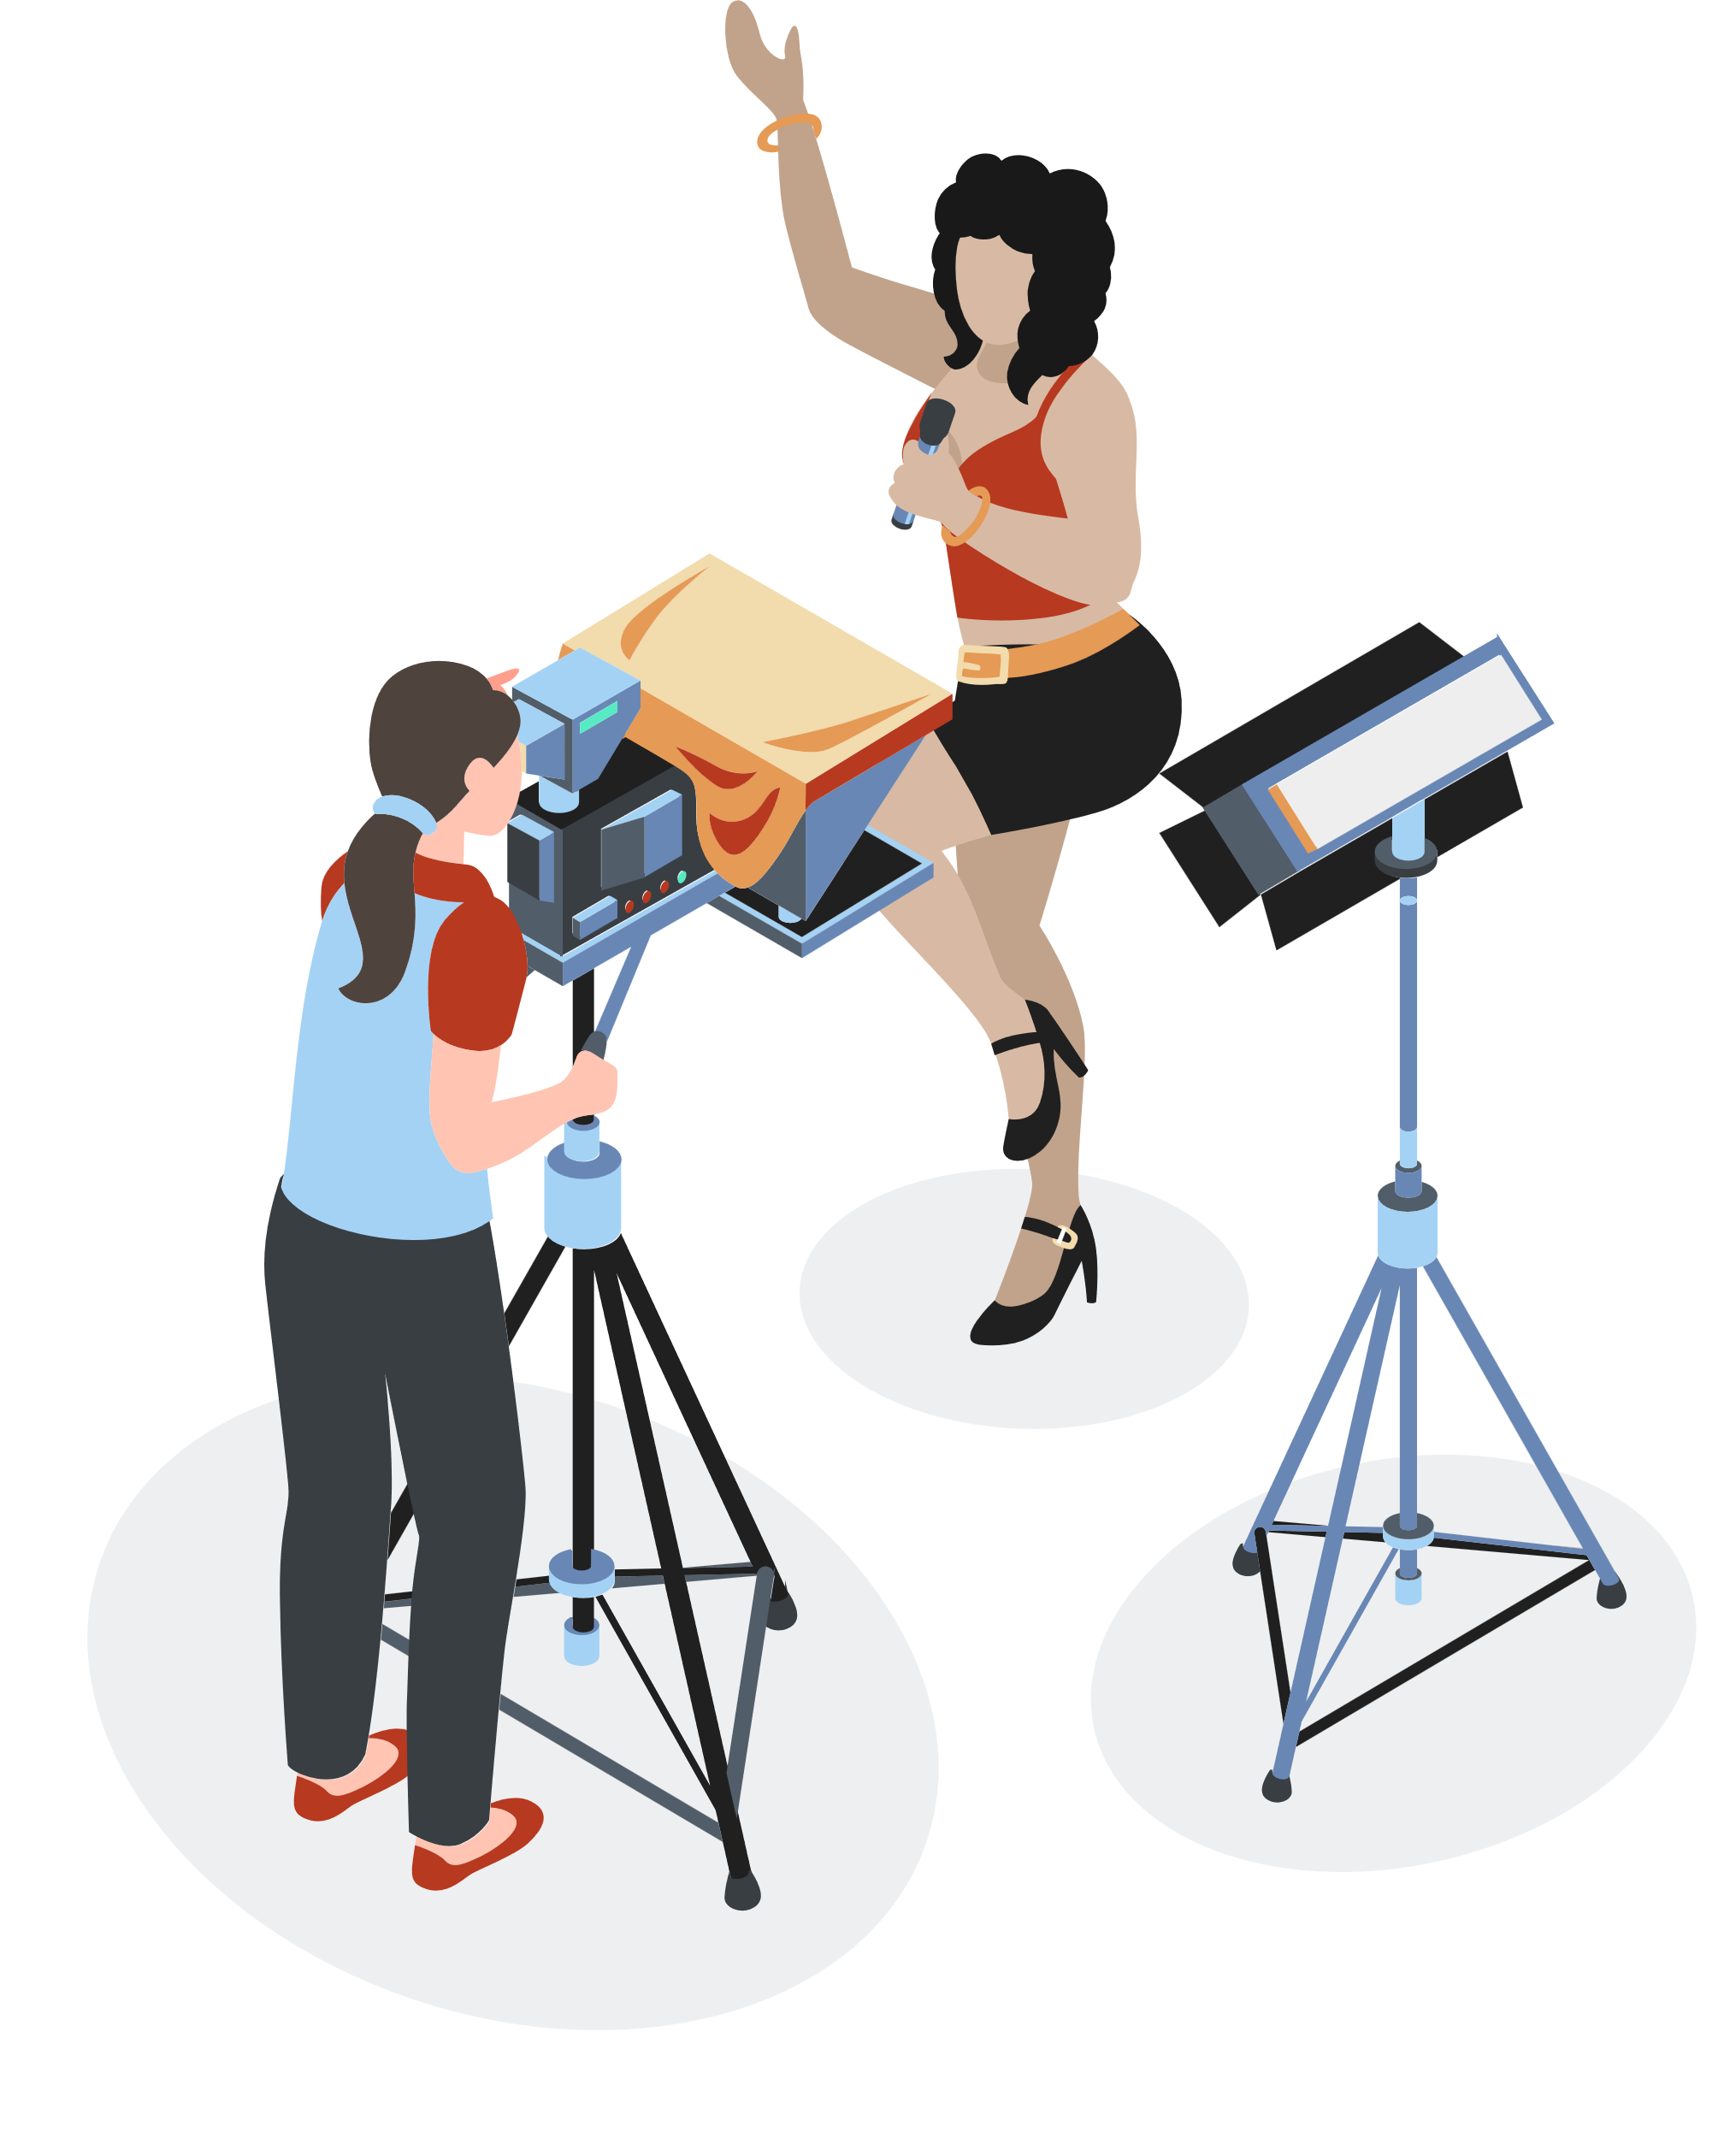
02
Discussion

Slide 11


Discussion
What is your favorite TV show?
Do you watch TV shows in English?
What types of TV shows do you not like?

Slide 12
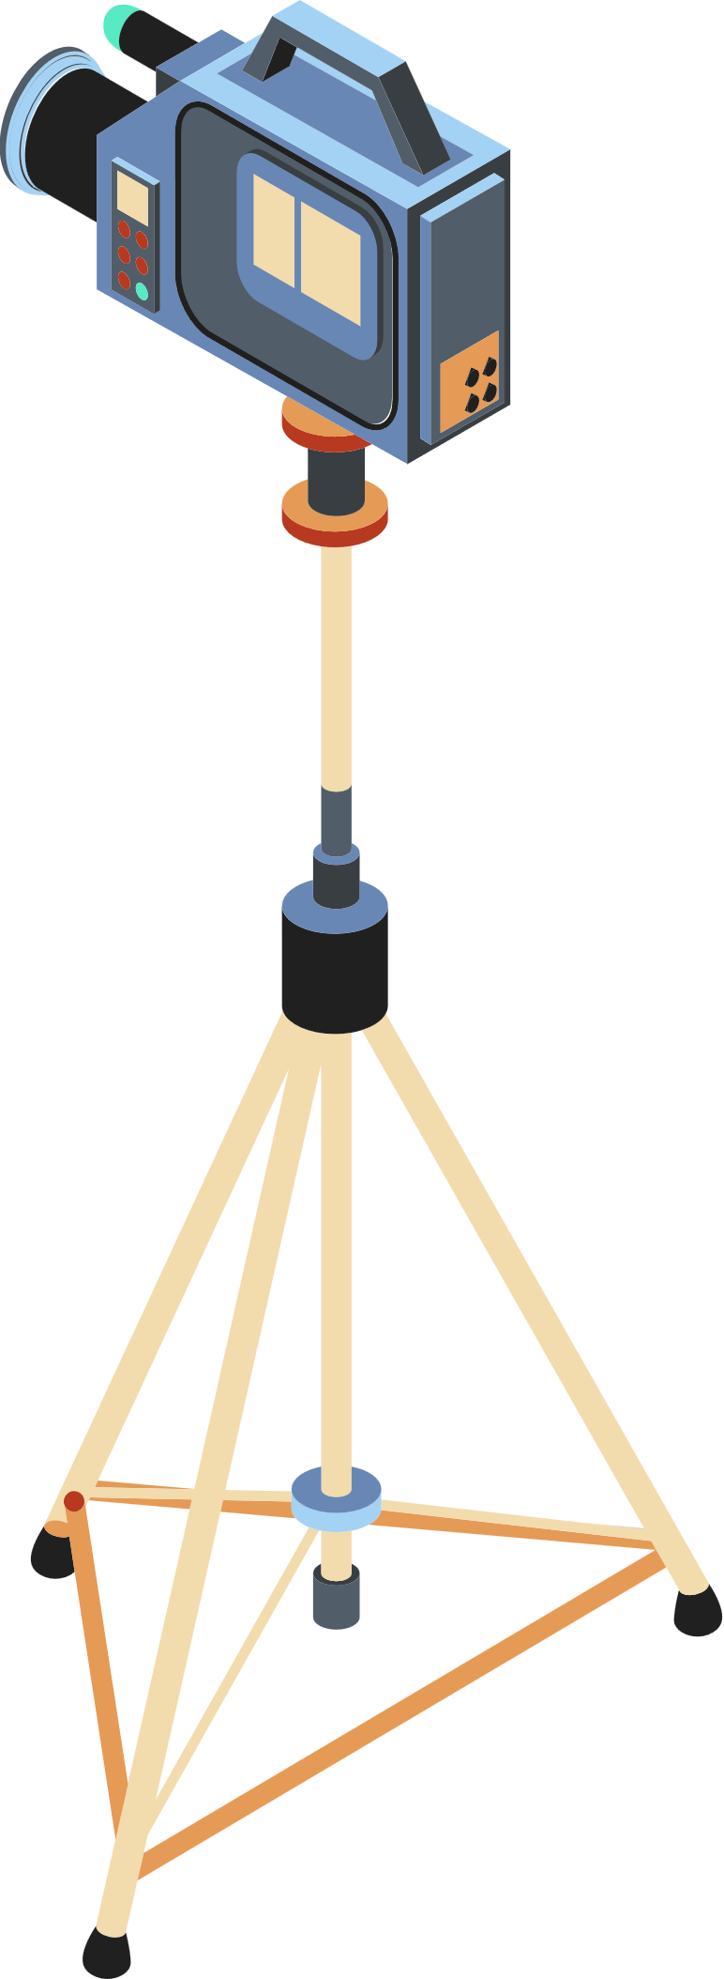
Discussion
What is your favorite TV series?
What TV series are you watching these days?
Do you ever watch TV series in their original language?

Slide 13

Discussion
Are there any TV series that you consider overrated? Why?
Do you prefer current TV shows or old TV shows?
What makes you decide to watch a TV show/ series (ex. a commercial, a good review)?

Slide 14


Thanks

